Slide 1

Electronic Performance Support Solutions
USCG Performance Technology Center (FC-tptc)
Steve Flowers

Slide 2
Electronic Performance Support Solutions
Embedded tools are available to / part of the work
USCG Performance Technology Center (FC-tptc)
Steve Flowers

Slide 3
Moments of need

Slide 4
According to Bob Mosher
and Conrad Gottfredson
There are 5 moments of learning need:
More
Change
New
Solve
Apply

Slide 5
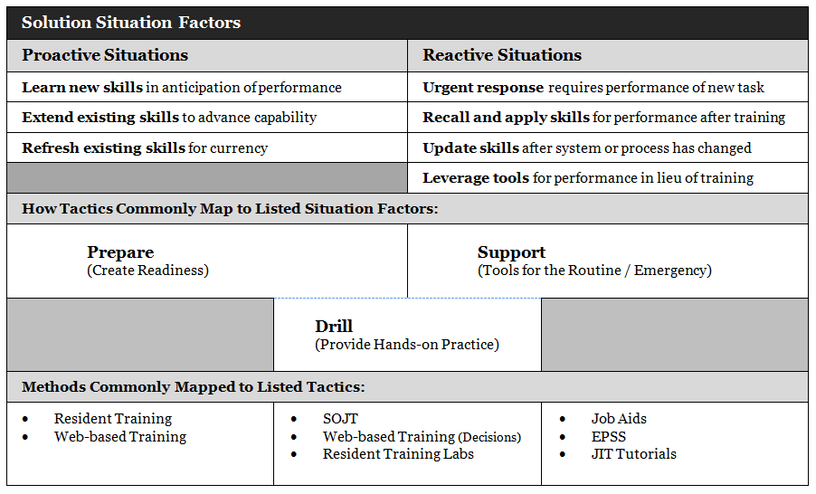
A similar take – this is a tool we’ve added to the USCG ADL SOP.

Slide 6
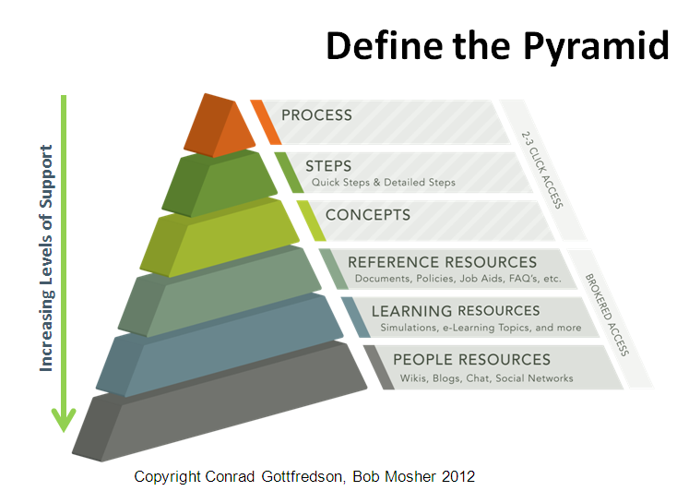
Want some context for this great diagram? See a great article from Conrad here: http://www.learningsolutionsmag.com/articles/1228/what-we-got-here-is--an-epss

Slide 7
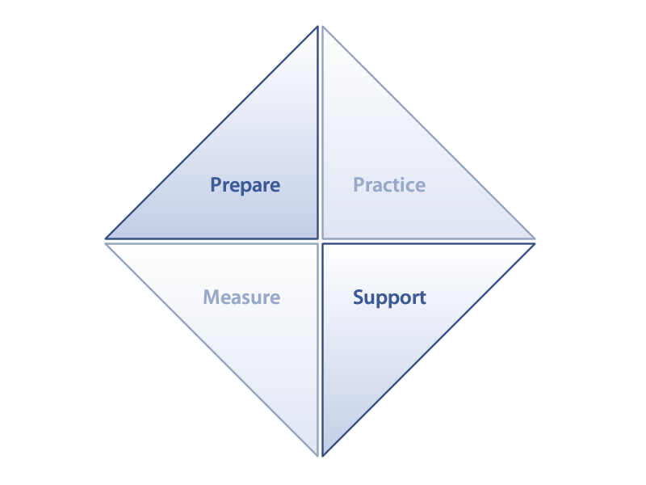
Concepts
Explanations
Simulations
Process & Steps
Reference

Slide 8
EPSS and Job Aids are TOOLS that can span
all performer states and levels of expertise
Not Getting
Not Yet
In Training
Long Ago
Training / Formal Skill Development

Slide 9
Heavier Focus
Tech Pubs Focus Here
Data
Knowledge
Task
Skill
Heavier Focus
Heavier Focus
Schools Focus Here
EPSS Focus Here

Slide 10
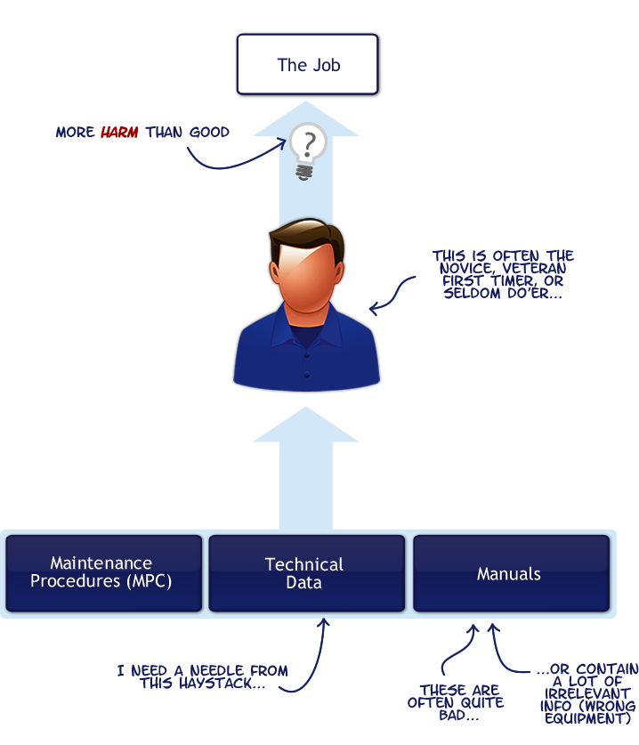

Slide 11
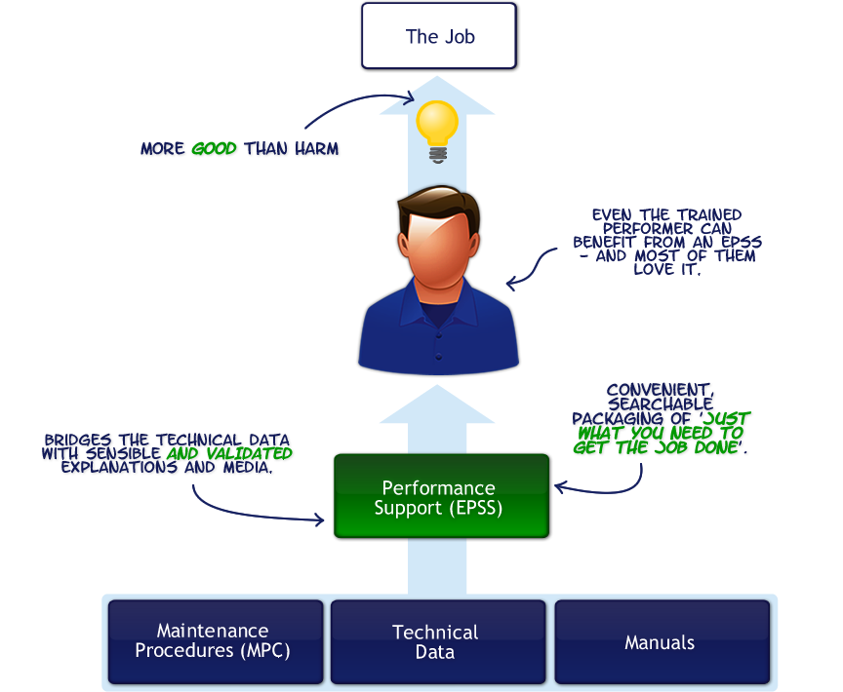

Slide 12
Design Process
Task Analysis > Validation > Capture

Slide 13
Design Process
Task Analysis > Validation > Capture
Results in focused curation of task support.
Intentional process that filters and amplifies value by collecting and maintaining a body of information over the life-cycle of the need.

Slide 14
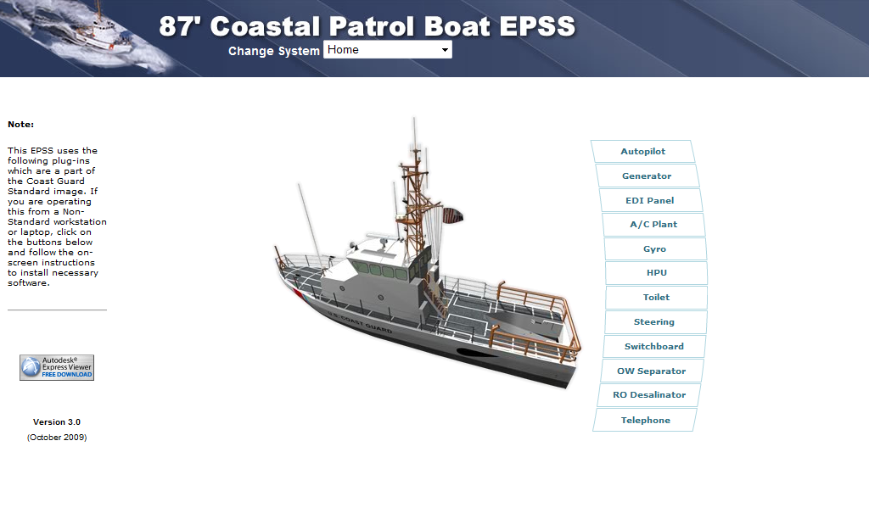

Slide 15


Survey results from evaluation…
This person also hates puppies.
94%
100%
Rated as good or excellent.
Saw value on other platforms.
Most thought the EPSS was easy to use and a must have as a consolidated reference.

Slide 16
‘The EPSS needs to
cover more systems.’

Slide 17
In the last two years we added the Gyro, Autopilot, HPU, OWS and RO.

Slide 18
We also evolved the product design in small increments.

Slide 19
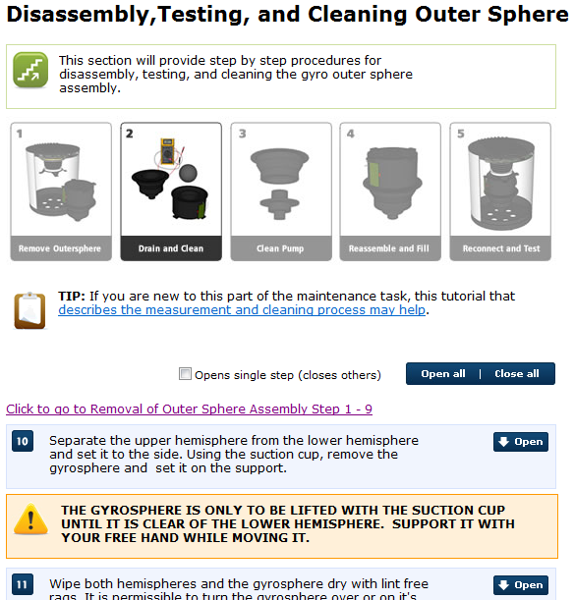
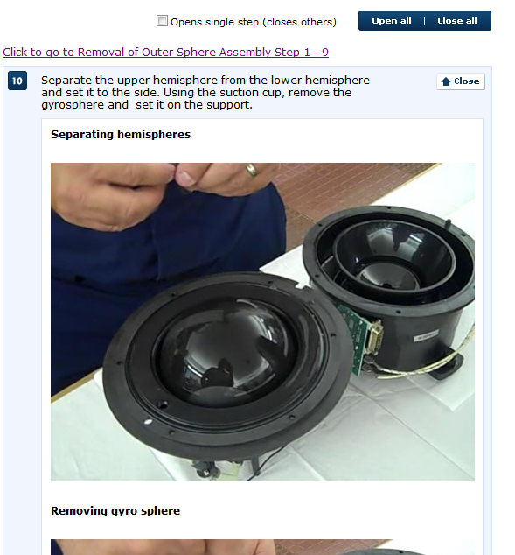
Adding content presentation strategies that tune information to the level of performer (apprentice, journeyman, master).

Slide 20
Fusing media into a reference hybrid available where the work is done.

Slide 21
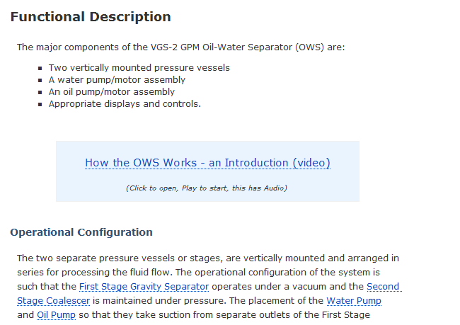
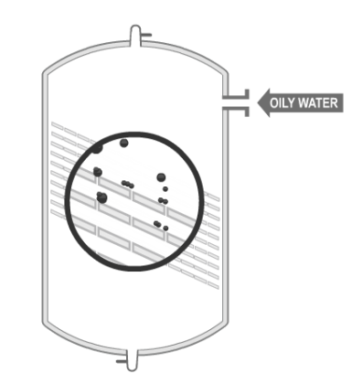
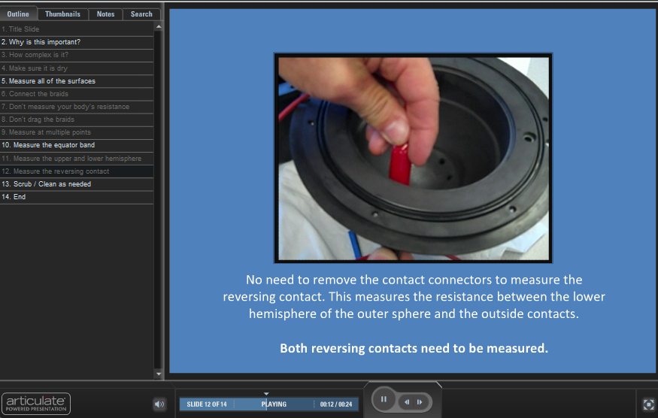
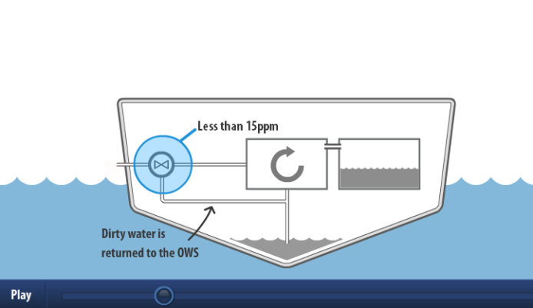
Adding skill builders and employing orientation strategies where necessary.

Slide 22
Long term…

Slide 23
Make them easy to find

Slide 24
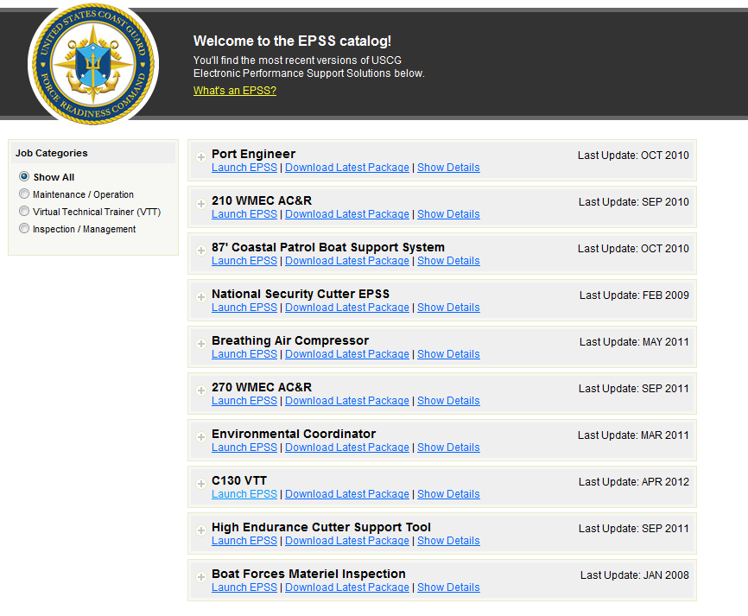

Slide 25

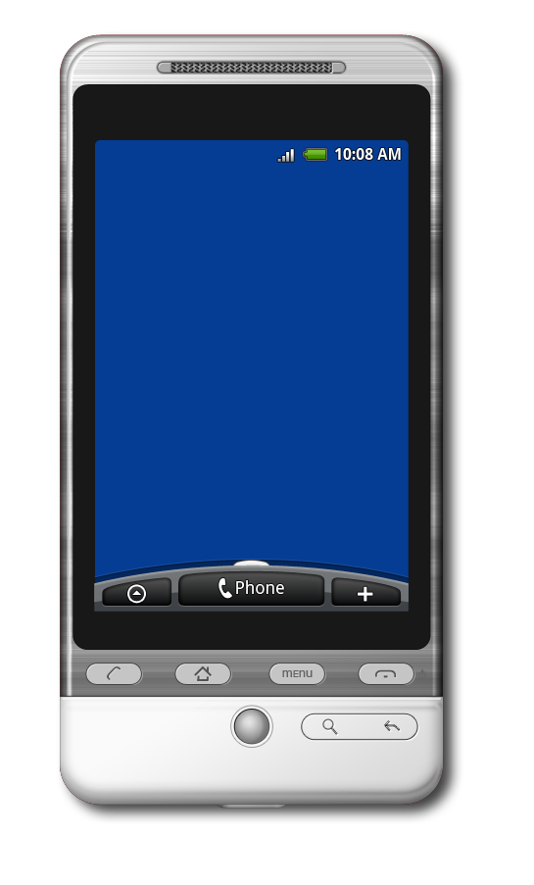
Usable across platforms

Slide 26
S1000D, DITA, Working with DCMS to integrate sustainable logistics and support products that dovetail with training services.

Slide 27
FORCECOM is primed to work with DCMS
to provide targeted and sustainable
technical and human performance support
to the people that need it the most.

Slide 28
USCG Performance Technology Center (FC-tptc)
Steve.T.Flowers@uscg.mil
757.856.2379

